Slide 1
The vide
1

Slide 2
copyright © 2020 all rights reserved to their respective owners :
-Serie Choufli Hal - Saison 2007 - Episode 20-from min 36:10 to 39:10(WATANIA)
-Special thanks to Mr. Hamdi, who generously provided us with full access to his work free of charge.
2

Slide 3
New Genic
Challenge Based Learning
3

Slide 4
Table of contents
01
02
Engagement
Investigation
The Big Idea
The Essential Questions
The Challenge
Generating Guiding Questions
Guiding Activities
Investigation Synthesis
4

Slide 5
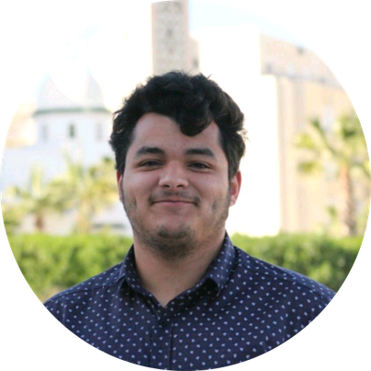
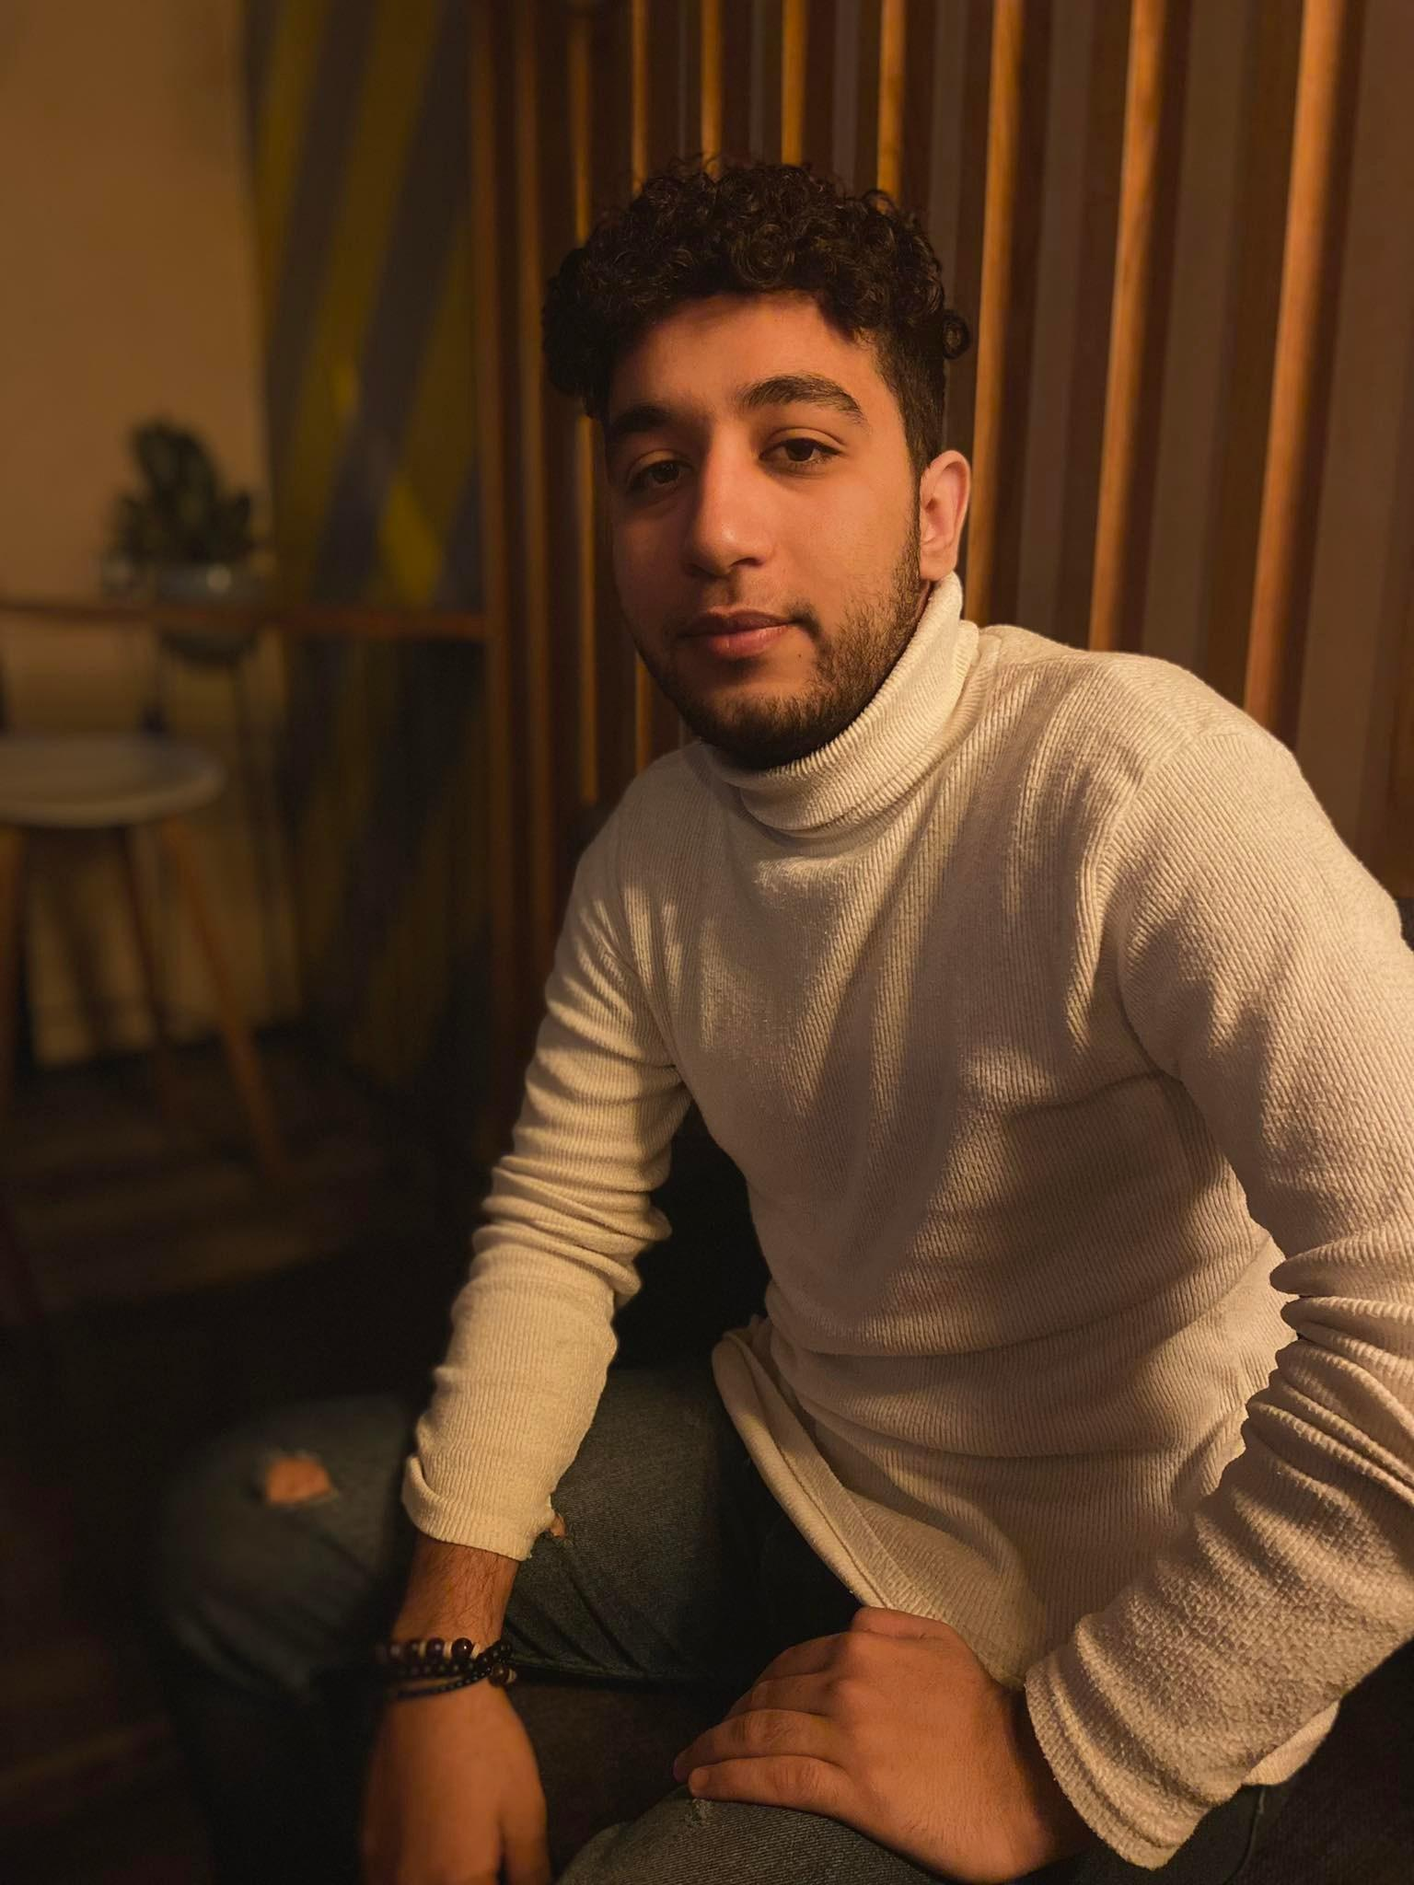
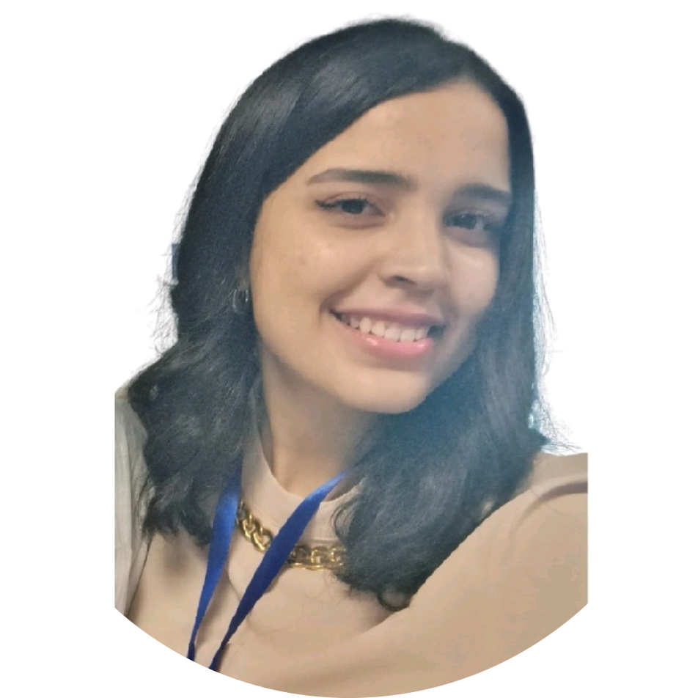
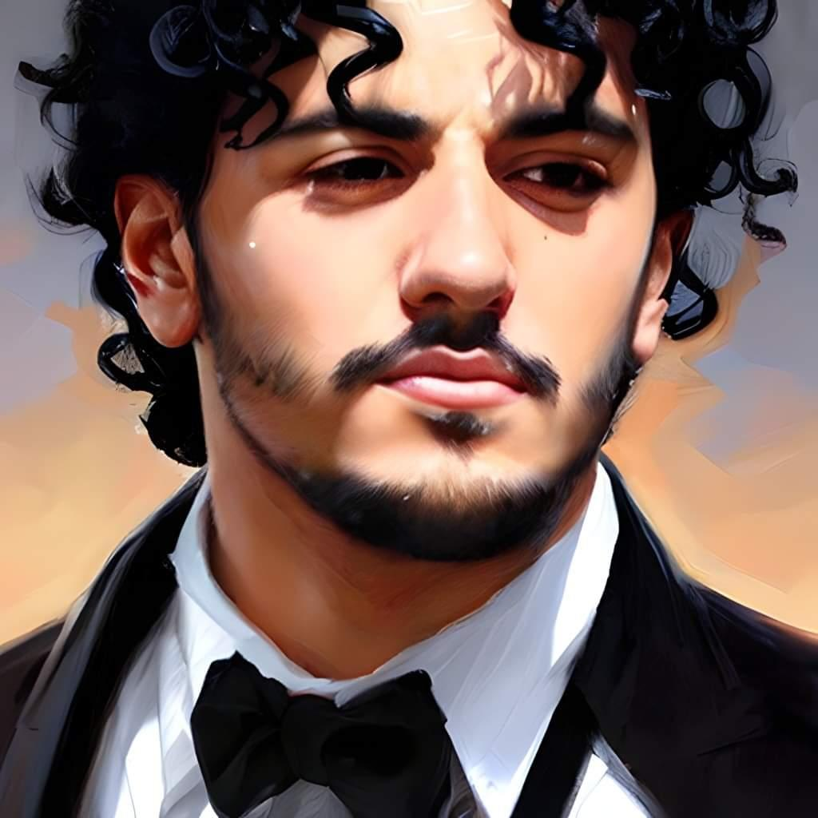
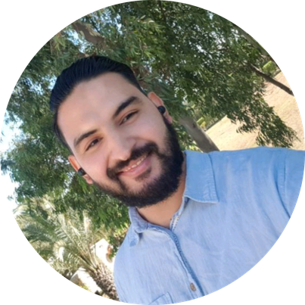
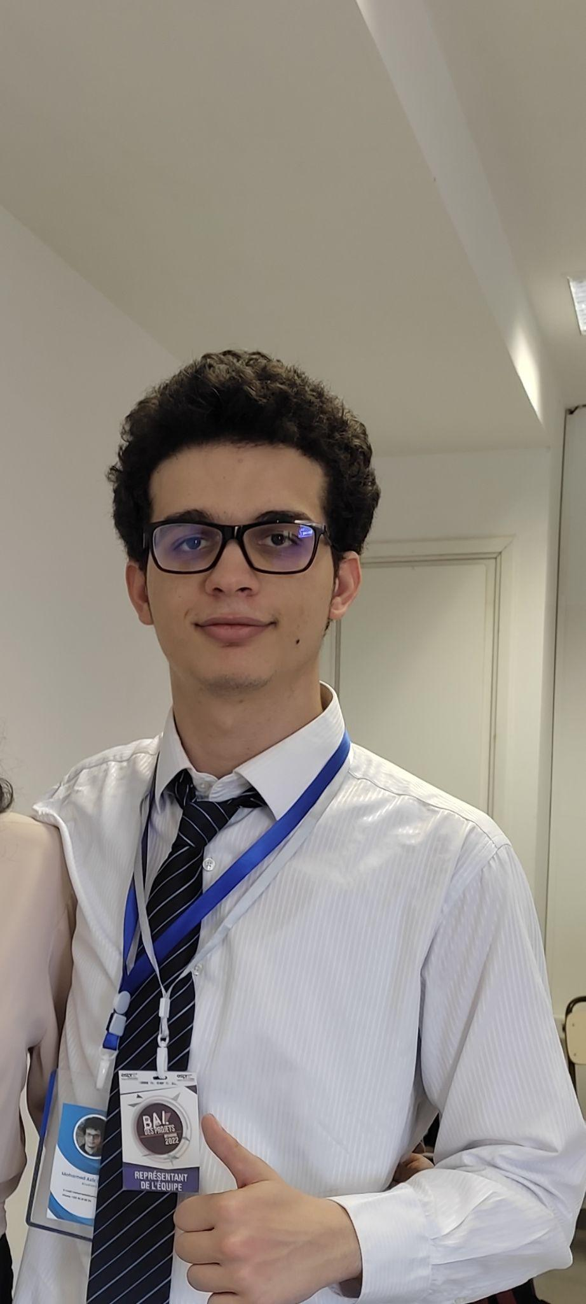
Our Team
Khaled Turki
Tijani Boujdaria
Aya Omezine
Walid Jlassi
Souhail Foudhaili
Mohamed Aziz Omezine
5

Slide 6
01
Engagement
The Big Idea
The Essential Questions
The Challenge
6

Slide 7
Introduction
7

Slide 8
The Big Idea
Apply CBL to healthcare to address some of the most pressing health challenges facing the world today.
8

Slide 9
The Essential Questions
What does it mean to be healthy?
What do we need to do to be healthy?
What are the barriers to being healthy?
Why should I take care of my health?
9

Slide 10
The Essential Questions
05
What behaviors positively and negatively impact our health?
What are long-term consequences of being unhealthy?
06
08
How does skin health relate to overall health and well-being?
What is the importance of skin health?
07
10

Slide 11
The Essential Question
How do we achieve a healthy life?
11

Slide 12
Selecting The Challenge
Identify the Health Issue
Evaluate the Impact
Conclusion
12

Slide 13
A healthy skin for a fresh life !
13

Slide 14
SDG
Sustainable Development Goals
14

Slide 15


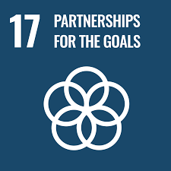
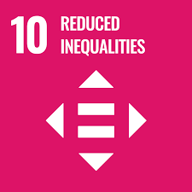

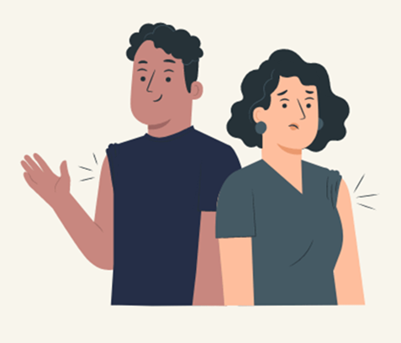
Sustainable Development Goals
Good Health and Well-being
Partnerships for the Goals
Reduced Inequalities
15

Slide 16
02
Investigation
Generating Guiding Questions
Guiding Activities
Investigation Synthesis
16

Slide 17
Generating Guiding Questions
What are the common skin disorders and diseases, and what are their causes and symptoms?
How can skin health be affected by lifestyle choices, such as diet, exercise, and sleep?
What are the risk factors for developing skin cancer, and how can it be prevented?
What are the current diagnostic and treatment methods for skin disorders, and what are their limitations?
How can technology, such as AI and machine learning, be used to improve the diagnosis and treatment of skin disorders?
How can healthcare systems be improved to provide better access to dermatological care, particularly in underserved communities?
17

Slide 18
Guiding Activities and Resources
Interview
Article
Website
Search
Healthline
Doximity
Medicalnewstoday
Wiley Online Library
The AAD website
Mayo Clinic
DermNet NZ
Cleveland Clinic
18

Slide 19
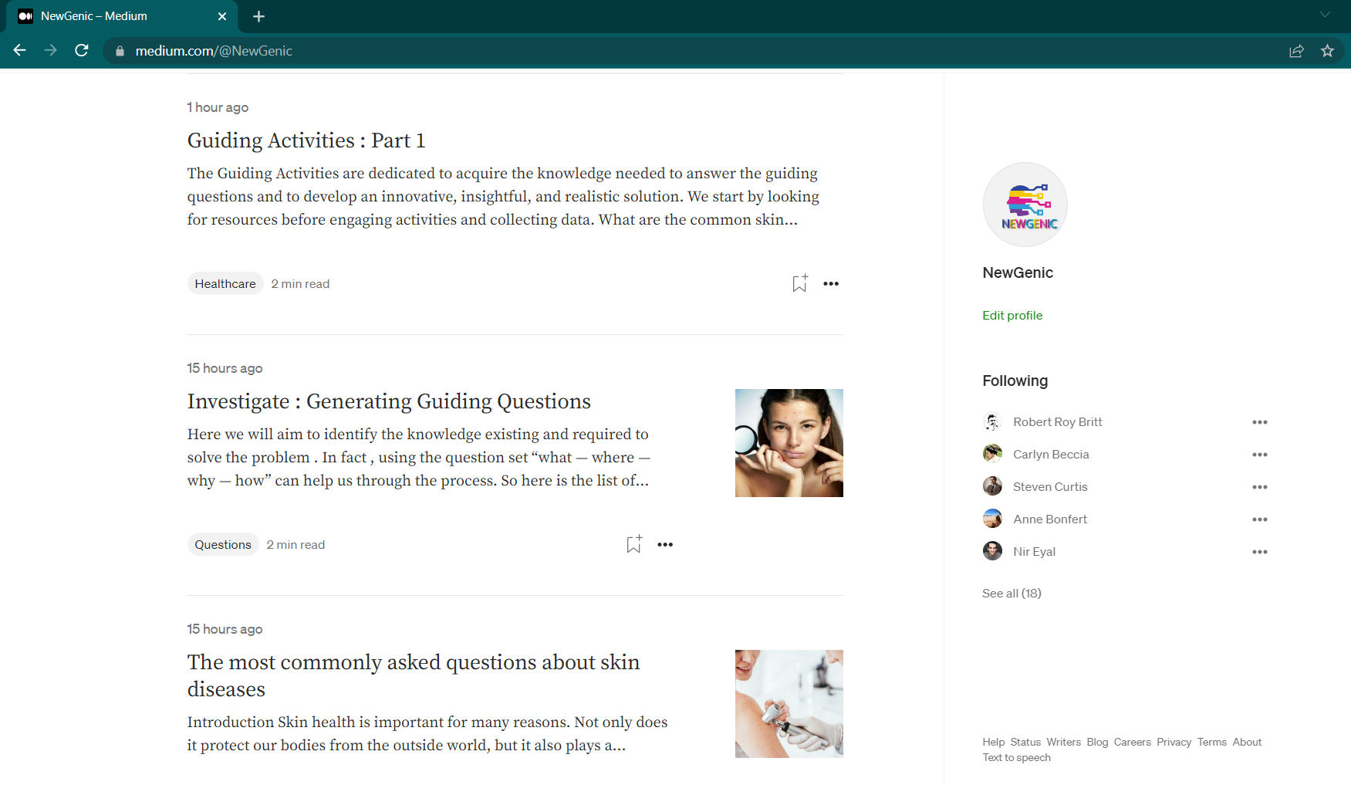
https://medium.com/@NewGenic
19

Slide 20
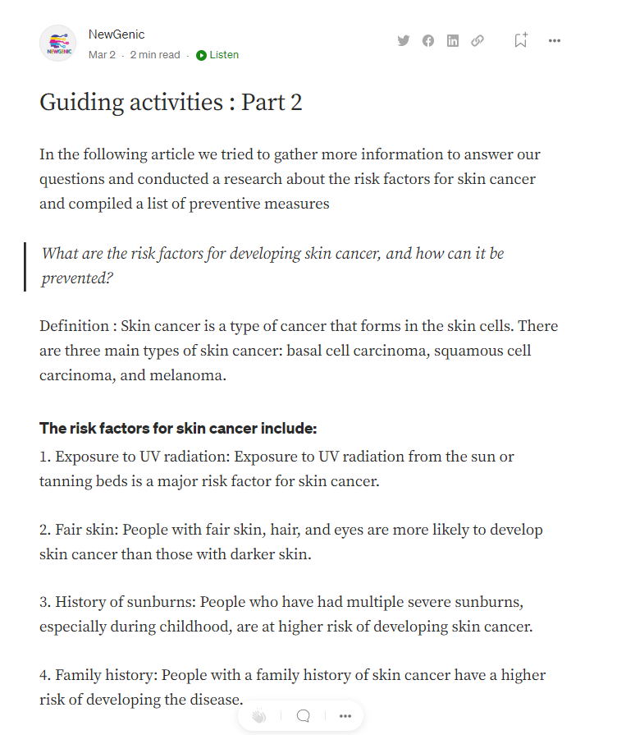
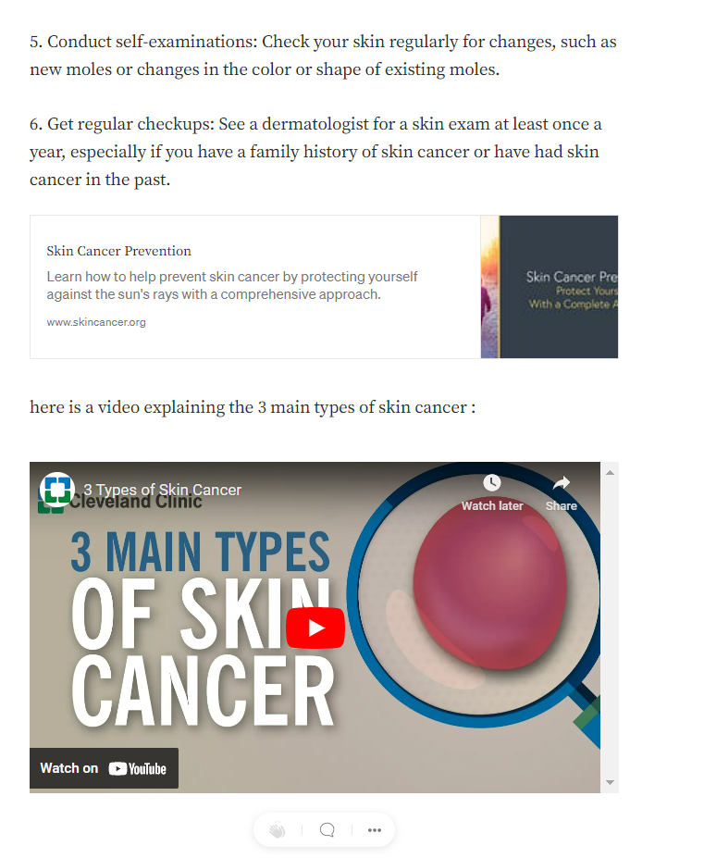
https://medium.com/@NewGenic
20

Slide 21
Investigation Synthesis
In the investigation synthesis step we will use critical thinking and problem-solving skills to evaluate the information gathered and identify the most important issues related to the challenge
21

Slide 22
Partnership
22

Slide 23

vide
Partnership
21

